Slide 1
Team B: EULA – NA East Karen Fine, Matt Marotto, Clifford Jones, Maria Carolina Bossert CARs to review: 173917114, 173917585, 173917263

Slide 2
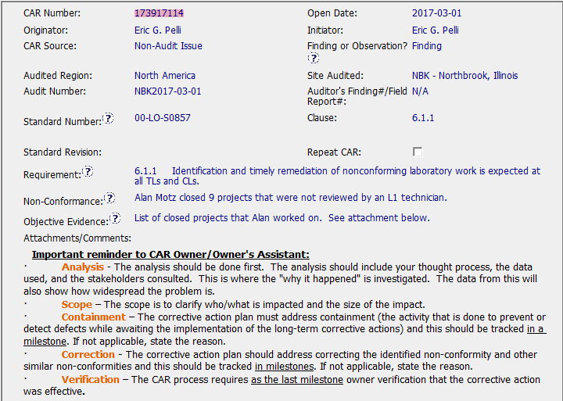

Slide 3
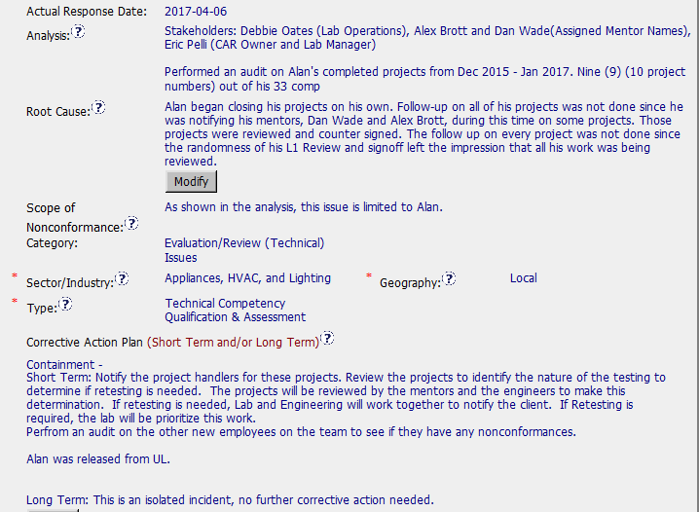

Slide 4
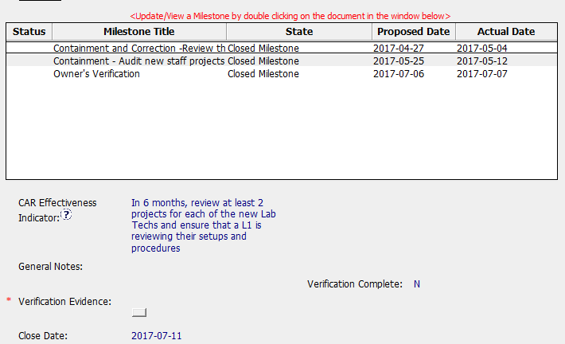

Slide 5
CAR Review - 173917114
Is the nonconformity is fully addressed in the analysis?
Analysis does not indicate clearly why the NC occurred.
The primary document was not mentioned, and why the activity was not done in accordance with that SOP.
What records (evidence) were evaluated to determine the work was being review?
The objective evidence doesn’t track with the cited document. This is a training process issue? More appropriate reference: 00-LO-S0855, Clause 4.2.1 “Laboratory Technicians are responsible for ensuring that they have the appropriate capability for testing that they perform, or that they have a trainer sign off on the datasheets.”
Does the analysis supports the root cause statement?
The Analysis does not support the root cause statement
The Root Cause is written more like an analysis, and does not specifically identify the root cause. The root cause uses terms like “impression” which are vague and does not decisively define the true root cause.
Does the analysis support the Scope of Nonconformance statement?
The analysis does not support the Scope of Nonconformance.
The scope of the non conformance indicates that the defect was limited to a single staff member yet the analysis does not provide objective evidence indicating that the defect was limited to a single staff member.
Will the Corrective Action Plan will prevent the recurrence of the nonconformity?
No, the Corrective Action Plan will not prevent a reoccurrence.
The CA plan falls short in developing a long term corrective action that will address why the individuals work escaped any type of scrutiny or review. Essentially, the staff member was allowed to perform their duties with little or no oversight. There is no Corrective action to address this concern.

Slide 6
CAR Review - 173917114
Did the containment milestone “stopped the bleeding”?
Yes the corrective actions did stop the bleeding.
The Containment/corrective actions included a review of all previous work with a plan for Traceback if required and a review of other staff’s work in the department.
Did all corrective action milestones are aligned to each item of the corrective action plan?
Yes, the cited milestones did align to the cited corrective actions, although the section containment millstone and the verification milestone were both audit based milestones for different staff members (L1 vs. non L1).
Did the verification milestone confirmed the effective implementation of the corrective action plan?
No, the verification step was simply an audit of newer staff's project work. The analysis and root cause
fell short of determining why the employee was allowed to perform their tasks under minimal supervision.
Note: The fact that the staff member was released from UL is not relevant to the Corrective Action and should have been included in the CAR. Also, it is noted that staff members names were used, which is something we should always try to avoid whenever possible.

Slide 7
CAR 173917114 - Tony Hsu (Q1-Q4) - Duncan Li (Q5-Q7)

Slide 8
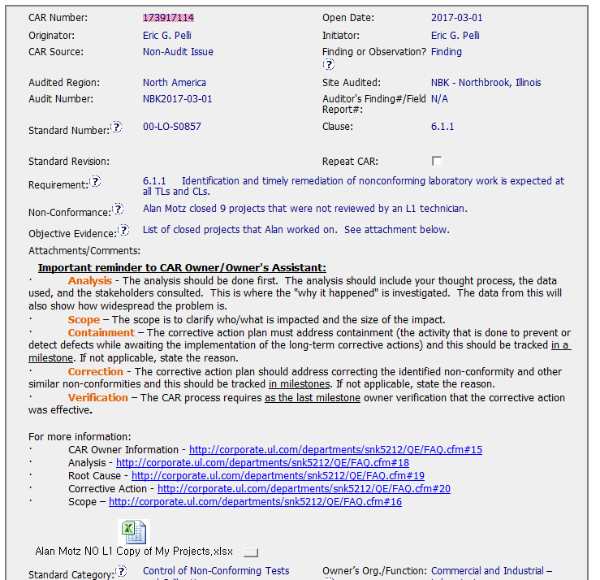
CAR 173917114
Additional Comment:
The 00-LC-S0857 requirements are not for the Non-Conformance.
If possible, the CAR Champion could suggest the requirements to why the projects need an L1 technician review in NBK since in other lab may have different requirements (ex. Need Lab Leader review).
Or if possible, the CAR Owner could add the requirements for why the projects need an L1 technician review in NBK in Analysis field since in other lab may have different requirements (ex. Need Lab Leader review).
1

Slide 9
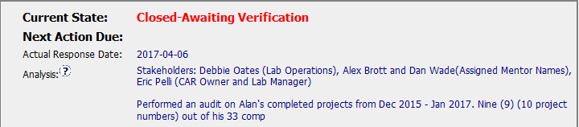
CAR 173917114
1
(Q1) Explain how/If the nonconformity is fully addressed in the analysis:
The analysis fully address the nonconformity by adopting an audit of Alan’s completed projects from Dec 2015 – Jan 2017.

Slide 10
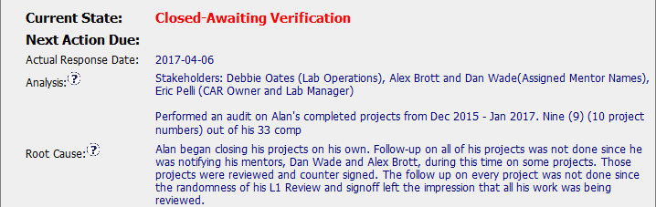
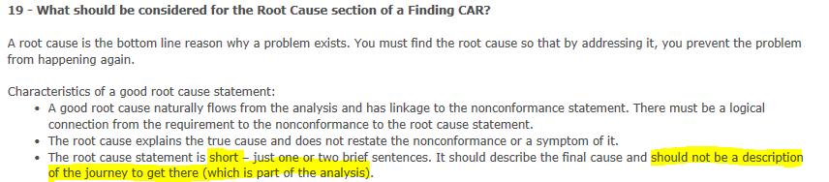
CAR 173917114
(Q2) Explain how/If the analysis supports the root cause statement:
The root cause looks like analysis instead of root cause statement. I could not catch the key points. An excel in CAR shows the audit results, could not reflect those “Analysis” statement in “Root Cause”
2
Additional Comment: For root cause, we could refer to CAR FAQ 19

Slide 11
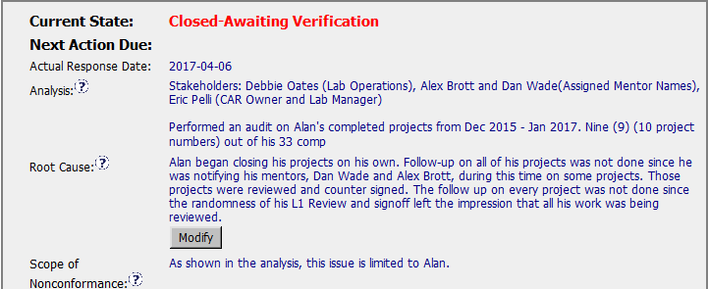
CAR 173917114
3
(Q3) Explain how/If the analysis supports the Scope of Nonconformance statement :
By referring to “analysis”, it looks like “analysis” support the “Scope of Nonconformance” statement.
However, at this moment (while response of CAR), we don’t know if the scope of Nonconformance only limited to “Alan”, since we have no audit data for other technician in the lab during root cause analysis phase.
Additional 5 technician’s projects were audited as “Containment”, may be included in the analysis will make the analysis better. But should be part of “analysis” instead of “Corrective Action Plan”.

Slide 12
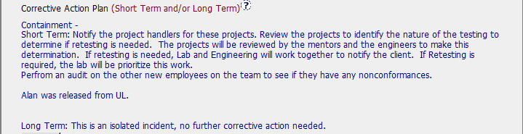
CAR 173917114
4
(Q4) Explain why/If the Corrective Action Plan will prevent the recurrence of the nonconformity:
Alan was released from UL could prevent the recurrence by Alan. We could not reach Alan for deeper root cause.
By analysis results, since only Alan was the only factor for Nonconformance, so the prevention is good.

Slide 13
CAR 173917114
5
(Q5) Explain how/If the containment milestone “stopped the bleeding”:
Yes, the involved CAS project handlers had been informed the issue, and projects had been requested to do review by the technician’s mentors and the CAS engineers for making certification determination.
Additionally, CAR Owner conducted an audit for the other new employees on the team to see if same issue can be found, and all Milestone Expectations had been provided as need.

Slide 14
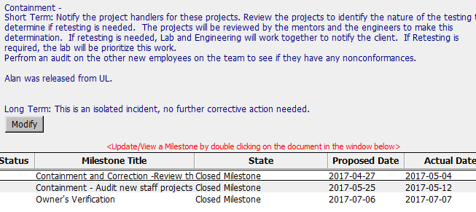
CAR 173917114
FAQ:
PS: CARs is not needed to indicate Short Term and Long Term plans, only need to indicate the specific action here, please refer to CAR FAQ requirement.
6
(Q6) Confirm that/If all corrective action milestones are aligned to each item of the corrective action plan:
A. Milestones cannot totally match to Corrective Action Plan. For example, there was no any milestone for Alan and Long Term’s actions. I would suggest to specific all action items and match to Corrective Action Plan.
B. Long Term action cannot served as corrective action due to it was just indicated analysis result to show it shall be an isolated case. I would suggest move it into Analysis.
C. Alan was released from UL, I believe it was not a good corrective action as well. Also, there was no any evidence for Alan left from UL (if this is acceptable corrective action).

Slide 15
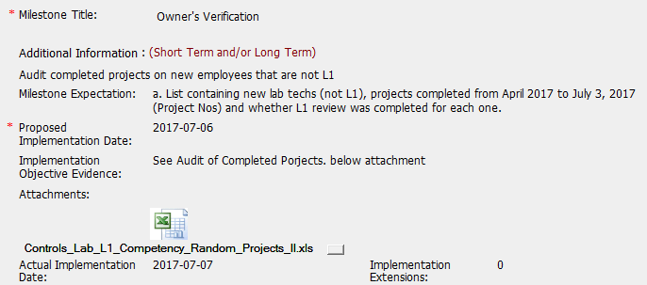
CAR 173917114
7
(Q7) Explain how/If the verification milestone confirmed the effective implementation of the corrective action plan:
Yes, they had done project review completed from April 2017 to July 3, 2017, there was no any similar issue can be found.
Additionally, I would suggest the Corrective Action Plan should additionally indicate Owner Verification item.

Slide 16
CAR 173917114
Criteria | CAR Review Results
(Q1) Explain how/If the nonconformity is fully addressed in the analysis | Partially, recommend to move some root cause statement into the analysis field to make analysis fully addressed the nonconformity.
(Q2) Explain how/If the analysis supports the root cause statement | Partially, recommend to move some root cause statement into the analysis field to support the root cause statement and make root cause statement short. Some audit results (additional 5 auditee) checked may confirm this is a single case.
(Q3) Explain how/If the analysis supports the Scope of Nonconformance statement | Fully. However, if possible, additional 5 auditee among other technician may also included in analysis is better.
(Q4) Explain why/If the Corrective Action Plan will prevent the recurrence of the nonconformity | Fully. Since Alan is the only factor and was release. We also could no reach Alan for deeper root cause to prevent the nonconformance.
(Q5) Explain how/If the containment milestone “stopped the bleeding” | Fully. CAR Owner has informed all involved CAS project handlers , and projects have been requested to do review by the technician’s mentors and the CAS engineers to make this determination.
(Q6) Confirm that/If all corrective action milestones are aligned to each item of the corrective action plan | Partially! Milestones does not totally match to Corrective Action Plan.
(Q7) Explain how/If the verification milestone confirmed the effective implementation of the corrective action plan | Fully. The project review did not show any repeat issue.

